Slide 1
CS 106A, Lecture 26 Final Exam Review 2

Slide 2
Plan for today
Announcements
HashMaps
Classes
Interactors
Final Exam Tips

Slide 3
Plan for today
Announcements
HashMaps
Classes
Interactors
Final Exam Tips

Slide 4
Announcements
Final Exam OAE Accommodations
Midterm Regrade Requests
End-Quarter LaIR and Office Hours
Graphics Contest (*drum roll 🥁*)

Slide 5
Karels

Slide 6


Slide 7


Slide 8


Slide 9


Slide 10
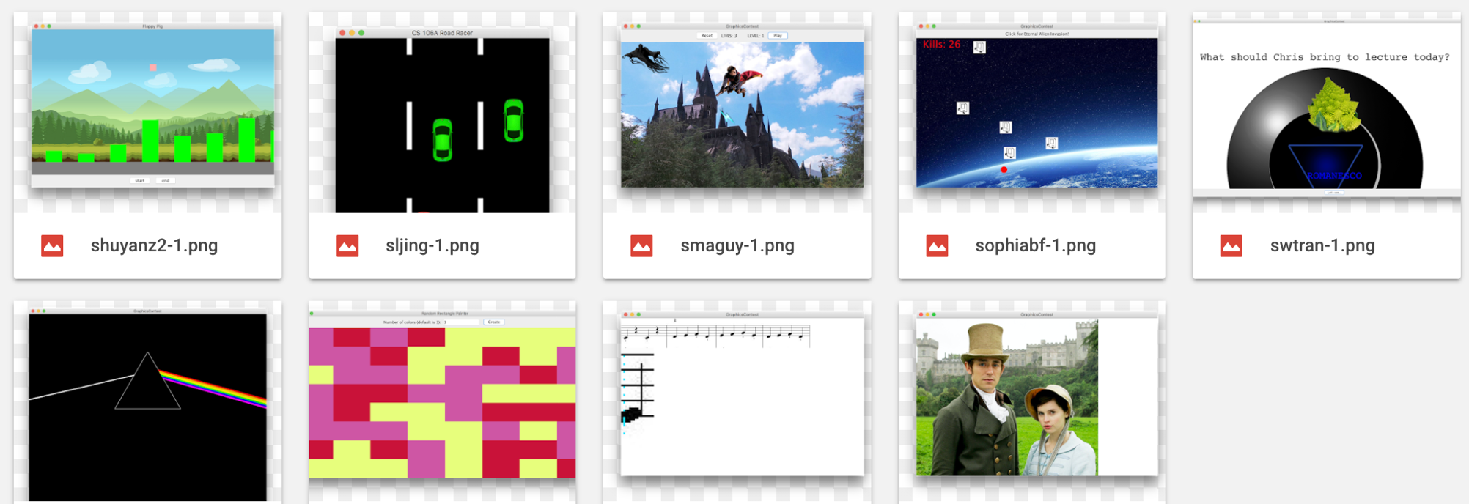

Slide 11
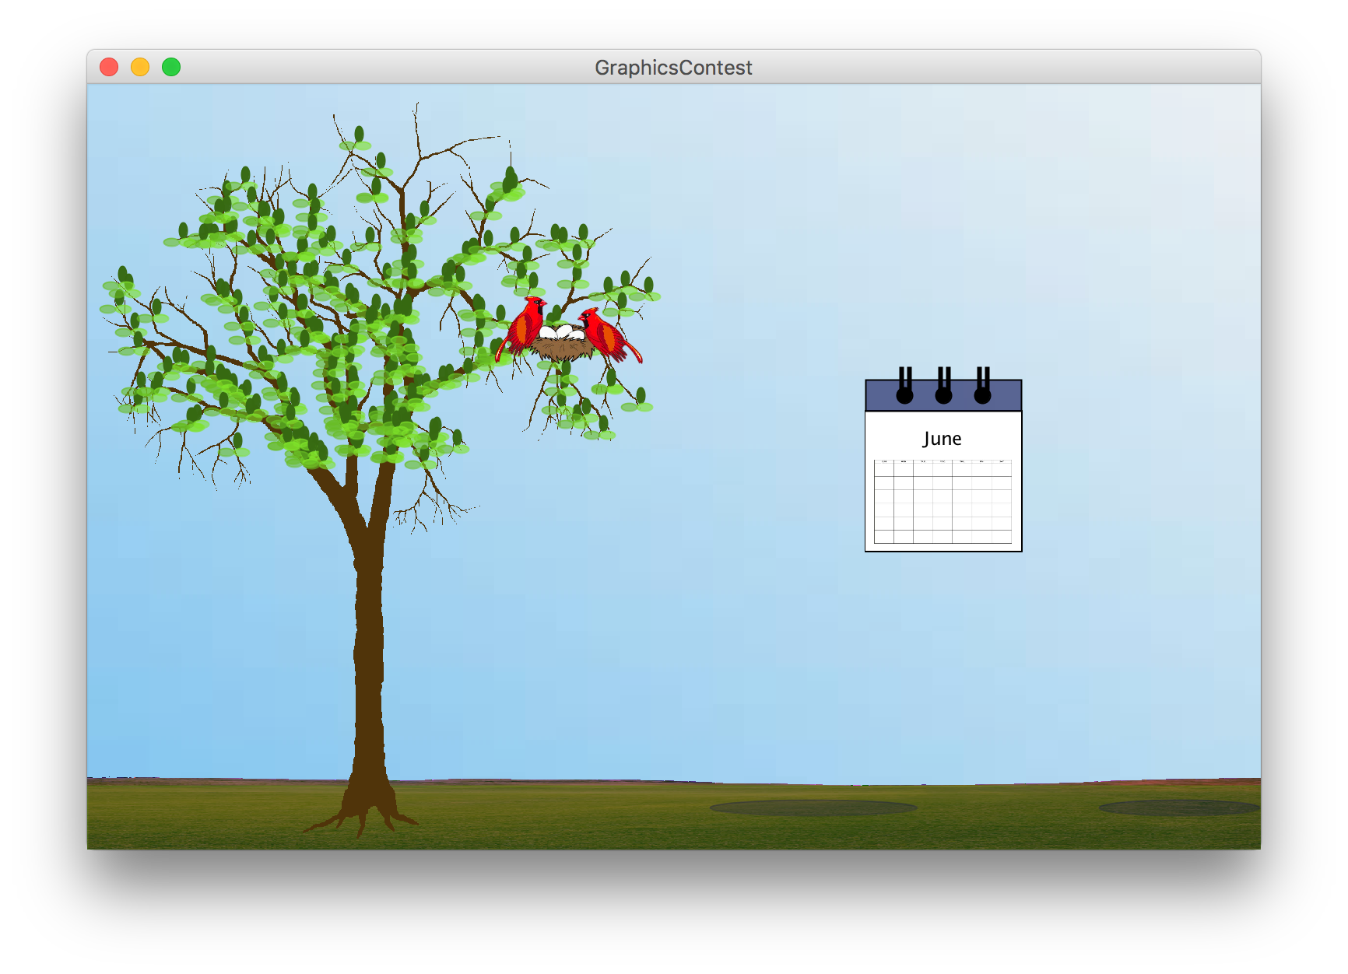
Winner: Aesthetics
Elina Thadhani

Slide 12
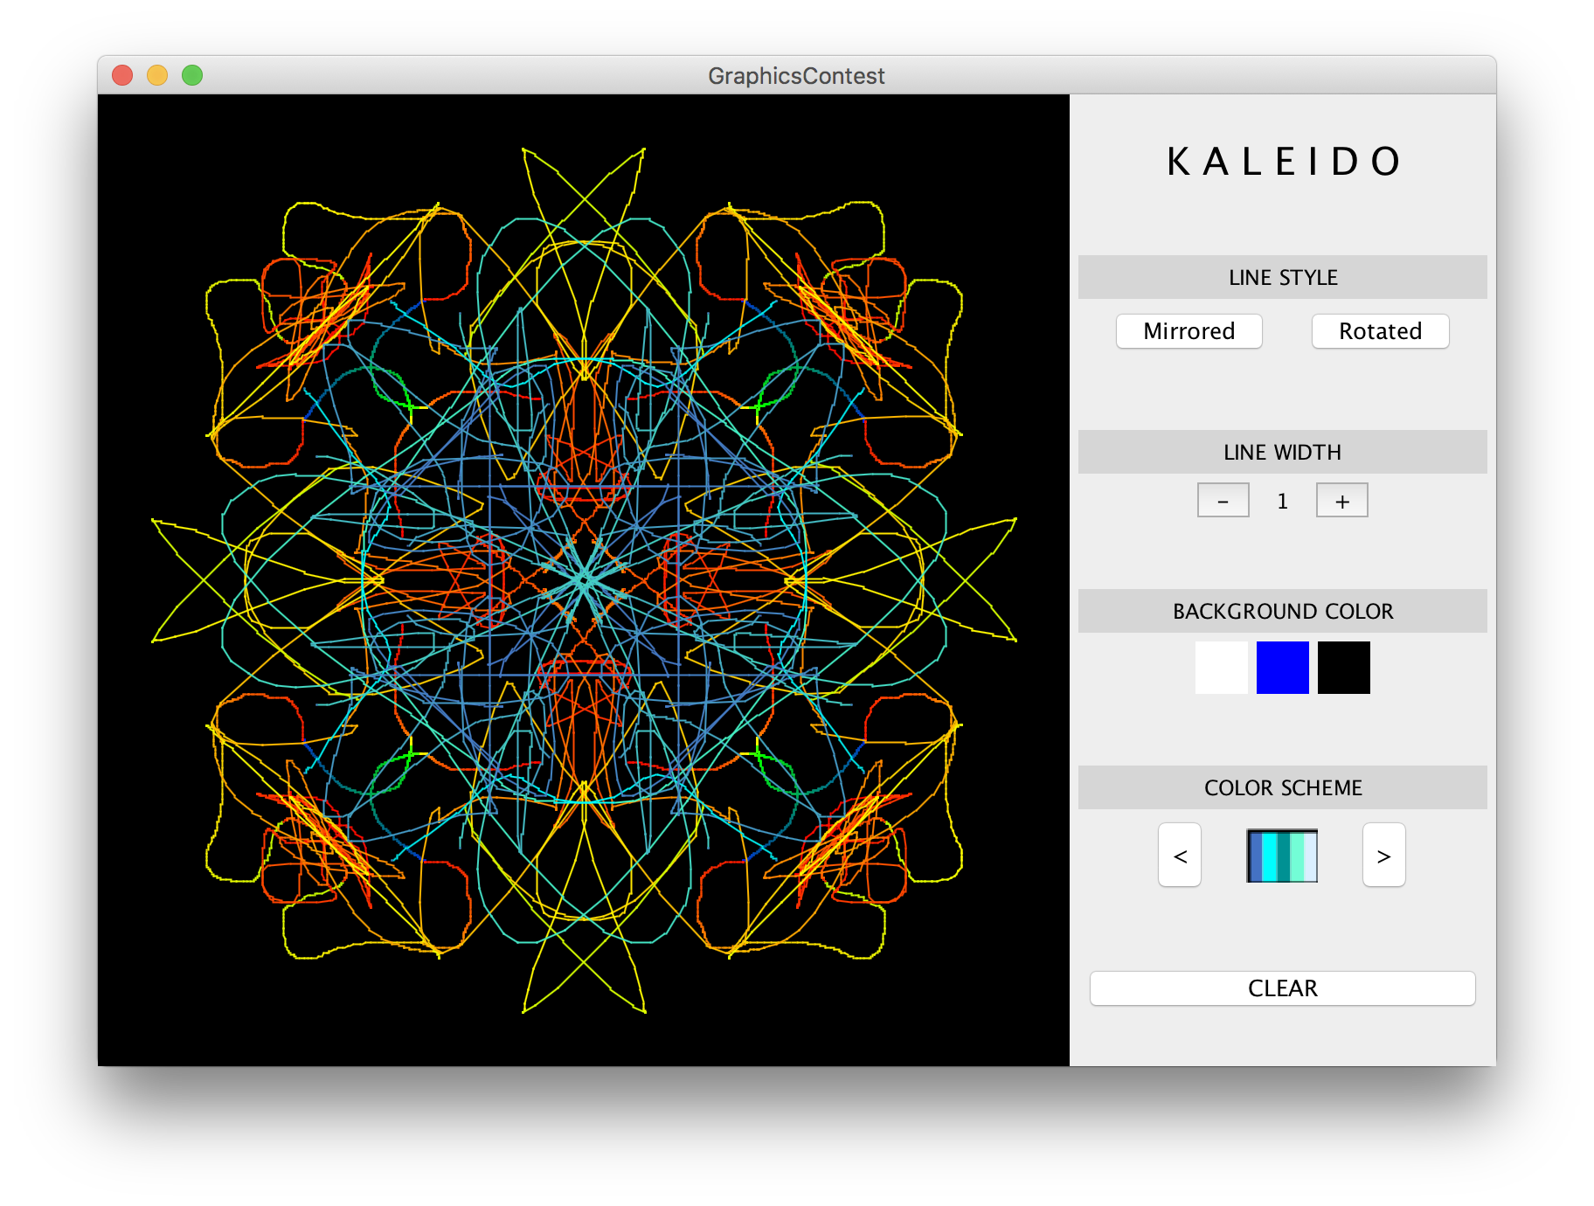
Winner: Algorithmics
Julianne Crawford

Slide 13

Winner: People’s Choice
Nicolas Guillen Barrail

Slide 14

Runner-Up
Nic Becker

Slide 15
Plan for today
Announcements
HashMaps
Classes
Interactors
Final Exam Tips

Slide 16
Review: HashMaps
 | String | Array | 2D Array | ArrayList | HashMap
Model | Sequence of letters or symbols | Fixed length elements in a list | Grid / Matrix of elements | Growable list of elements | Key/Value mapping
Type of element | chars | Objects & Primitives | Objects & Primitives | Objects | Object/Object
Access Elements | str.charAt(i); | arr[i]; | arr[r][c]; | list.get(i); list.set(i, elem) list.add(elem) | map.put(key, value) map.get(key);
Special notes | Immutable | Watch bounds! | Row, col structure | Just fantastic | Each key must be unique. Unordered
Examples | ”Hello world” | Histogram | ImageShop pixels | Hangman words, entries in namesurfer | NSDatabase, FPDatabase

Slide 17
Review: HashMaps
 | String | Array | 2D Array | ArrayList | HashMap
Model | Sequence of letters or symbols | Fixed length elements in a list | Grid / Matrix of elements | Growable list of elements | Key/Value mapping
Type of element | chars | Objects & Primitives | Objects & Primitives | Objects | Object/Object
Access Elements | str.charAt(i); | arr[i]; | arr[r][c]; | list.get(i); list.set(i, elem) list.add(elem) | map.put(key, value) map.get(key);
Special notes | Immutable | Watch bounds! | Row, col structure | Just fantastic | Each key must be unique. Unordered
Examples | ”Hello world” | Histogram | ImageShop pixels | Hangman words, entries in namesurfer | NSDatabase

Slide 18
Review: HashMaps
A variable type that represents a collection of key-value pairs
You access values by key, and all keys are unique
Keys and values can be any type of object (use wrapper classes to store primitives)
Resizable – can add and remove pairs
Has a variety of methods you can use, including .containsKey, .put, .get, etc.

Slide 19
Key Idea: Association
Phone book: name -> phone number
Search engine: URL -> webpage
Dictionary: word -> definition
Bank: account # -> balance
Social Network: name -> profile
Counter: text -> # occurrences
And many more…

Slide 20
Review: HashMap Operations
m.put(key, value); Adds a key/value pair to the map.
m.put("Eric", "650-123-4567");
Replaces any previous value for that key.
m.get(key) Returns the value paired with the given key.
String phoneNum = m.get("Jenny"); // "867-5309"
Returns null if the key is not found.
m.remove(key); Removes the given key and its paired value.
m.remove("Rishi");
Has no effect if the key is not in the map.
key value
"Jenny” → "867-5309"
"Mehran" → "123-4567"
"Marty" → "685-2181"
"Chris” → "947-2176"

Slide 21
Review: HashMap Operations
m.containsKey(key); Returns true if the key is in the map, false otherwise
m.size(); Returns the number of key/value pairs in the map.
To iterate over a map:
for (KeyType key : map.keySet()) {
ValueType value = map.get(key);
// Do something with key and/or value
}

Slide 22
What data structure should I use?
Use an array if…
Order matters for your information
You know how many elements you will store
You need the most efficiency
Use an ArrayList if…
Order matters for your information
You do not know how many elements you will store, or need to resize
You need to use ArrayList methods
Use a HashMap if…
Order doesn’t matter for your information
You need to store an association between two types of information
You do not know how many elements you will store, or need to resize
You need to use HashMap methods

Slide 23
Practice: Anagrams
Write a program to find all anagrams of a word the user types.
Type a word [Enter to quit]: scared
Anagrams of scared:
cadres cedars sacred scared
Assume you are given a dictionary.txt file containing words in the dictionary.
How can a HashMap help us solve this problem?

Slide 24
Key Idea: Anagrams
Every word has a sorted form where its letters are arranged into alphabetical order.
"fare" → "aefr"
"fear" → "aefr"
"swell" → "ellsw"
"wells" → "ellsw"
Notice that anagrams have the same sorted form as each other.
Assume we provide a String sortLetters(String s) method that takes a string and returns the string with its characters alphabetically ordered.

Slide 25
Anagrams Solution
public void run() {
HashMap<String, ArrayList<String>> anagrams = createAnagramsMap();
// prompt user for words and look up anagrams in map
while (true) {
String word = readLine("Type a word [Enter to quit]: ");
if (word.length() == 0) {
break;
}
String sorted = sortLetters(word.toLowerCase());
if (anagrams.containsKey(sorted)) {
println("Anagrams of " + word + ":");
println(anagrams.get(sorted));
} else {
println("No anagrams for " + word + ".");
}
}
}

Slide 26
Anagrams Solution
public void run() {
HashMap<String, ArrayList<String>> anagrams = createAnagramsMap();
// prompt user for words and look up anagrams in map
while (true) {
String word = readLine("Type a word [Enter to quit]: ");
if (word.length() == 0) {
break;
}
String sorted = sortLetters(word.toLowerCase());
if (anagrams.containsKey(sorted)) {
println("Anagrams of " + word + ":");
println(anagrams.get(sorted));
} else {
println("No anagrams for " + word + ".");
}
}
}

Slide 27
Anagrams Solution
public void run() {
HashMap<String, ArrayList<String>> anagrams = createAnagramsMap();
// prompt user for words and look up anagrams in map
while (true) {
String word = readLine("Type a word [Enter to quit]: ");
if (word.length() == 0) {
break;
}
String sorted = sortLetters(word.toLowerCase());
if (anagrams.containsKey(sorted)) {
println("Anagrams of " + word + ":");
println(anagrams.get(sorted));
} else {
println("No anagrams for " + word + ".");
}
}
}

Slide 28
Anagrams Solution
public void run() {
HashMap<String, ArrayList<String>> anagrams = createAnagramsMap();
// prompt user for words and look up anagrams in map
while (true) {
String word = readLine("Type a word [Enter to quit]: ");
if (word.length() == 0) {
break;
}
String sorted = sortLetters(word.toLowerCase());
if (anagrams.containsKey(sorted)) {
println("Anagrams of " + word + ":");
println(anagrams.get(sorted));
} else {
println("No anagrams for " + word + ".");
}
}
}

Slide 29
Anagrams Solution
public void run() {
HashMap<String, ArrayList<String>> anagrams = createAnagramsMap();
// prompt user for words and look up anagrams in map
while (true) {
String word = readLine("Type a word [Enter to quit]: ");
if (word.length() == 0) {
break;
}
String sorted = sortLetters(word.toLowerCase());
if (anagrams.containsKey(sorted)) {
println("Anagrams of " + word + ":");
println(anagrams.get(sorted));
} else {
println("No anagrams for " + word + ".");
}
}
}

Slide 30
Anagrams Solution
public void run() {
HashMap<String, ArrayList<String>> anagrams = createAnagramsMap();
// prompt user for words and look up anagrams in map
while (true) {
String word = readLine("Type a word [Enter to quit]: ");
if (word.length() == 0) {
break;
}
String sorted = sortLetters(word.toLowerCase());
if (anagrams.containsKey(sorted)) {
println("Anagrams of " + word + ":");
println(anagrams.get(sorted));
} else {
println("No anagrams for " + word + ".");
}
}
}

Slide 31
Anagrams Solution, Part 2
/*
* This method reads in the dictionary.txt file and creates a map
* from a sorted string of characters to all words made up of those
* characters. e.g. “acers” -> {“scare”, “cares”,...}
*/
private HashMap<String, ArrayList<String>> createAnagramsMap() {
HashMap<String, ArrayList<String>> anagrams = new HashMap<String,
ArrayList<String>>();
try {
Scanner scanner = new Scanner(new File("dictionary.txt"));
while (scanner.hasNextLine()) {
String word = scanner.nextLine();
String sorted = sortLetters(word);
...

Slide 32
Anagrams Solution, Part 2
/*
* This method reads in the dictionary.txt file and creates a map
* from a sorted string of characters to all words made up of those
* characters. e.g. “acers” -> {“scare”, “cares”,...}
*/
private HashMap<String, ArrayList<String>> createAnagramsMap() {
HashMap<String, ArrayList<String>> anagrams = new HashMap<String,
ArrayList<String>>();
try {
Scanner scanner = new Scanner(new File("dictionary.txt"));
while (scanner.hasNextLine()) {
String word = scanner.nextLine();
String sorted = sortLetters(word);
...

Slide 33
Anagrams Solution, Part 2
/*
* This method reads in the dictionary.txt file and creates a map
* from a sorted string of characters to all words made up of those
* characters. e.g. “acers” -> {“scare”, “cares”,...}
*/
private HashMap<String, ArrayList<String>> createAnagramsMap() {
HashMap<String, ArrayList<String>> anagrams = new HashMap<String,
ArrayList<String>>();
try {
Scanner scanner = new Scanner(new File("dictionary.txt"));
while (scanner.hasNextLine()) {
String word = scanner.nextLine();
String sorted = sortLetters(word);
...

Slide 34
Anagrams Solution, Part 2
/*
* This method reads in the dictionary.txt file and creates a map
* from a sorted string of characters to all words made up of those
* characters. e.g. “acers” -> {“scare”, “cares”,...}
*/
private HashMap<String, ArrayList<String>> createAnagramsMap() {
HashMap<String, ArrayList<String>> anagrams = new HashMap<String,
ArrayList<String>>();
try {
Scanner scanner = new Scanner(new File("dictionary.txt"));
while (scanner.hasNextLine()) {
String word = scanner.nextLine();
String sorted = sortLetters(word);
...

Slide 35
Anagrams Solution, Part 2
/*
* This method reads in the dictionary.txt file and creates a map
* from a sorted string of characters to all words made up of those
* characters. e.g. “acers” -> {“scare”, “cares”,...}
*/
private HashMap<String, ArrayList<String>> createAnagramsMap() {
HashMap<String, ArrayList<String>> anagrams = new HashMap<String,
ArrayList<String>>();
try {
Scanner scanner = new Scanner(new File("dictionary.txt"));
while (scanner.hasNextLine()) {
String word = scanner.nextLine();
String sorted = sortLetters(word);
...

Slide 36
Anagrams Solution, Part 2
/* Either get the current word list,
* or make a new empty one. */
ArrayList<String> words;
if (anagrams.containsKey(sorted)) {
words = anagrams.get(sorted);
} else {
words = new ArrayList<String>();
}
// Update the list with our new word
words.add(word);
anagrams.put(sorted, words);
}
scanner.close();
} catch (IOException ex) {
println("Error reading file dictionary.txt.");
}
return anagrams;
}

Slide 37
Anagrams Solution, Part 2
/* Either get the current word list,
* or make a new empty one. */
ArrayList<String> words;
if (anagrams.containsKey(sorted)) {
words = anagrams.get(sorted);
} else {
words = new ArrayList<String>();
}
// Update the list with our new word
words.add(word);
anagrams.put(sorted, words);
}
scanner.close();
} catch (IOException ex) {
println("Error reading file dictionary.txt.");
}
return anagrams;
}
Notes:
Key pattern!

Slide 38
Anagrams Solution, Part 2
/* Either get the current word list,
* or make a new empty one. */
ArrayList<String> words;
if (anagrams.containsKey(sorted)) {
words = anagrams.get(sorted);
} else {
words = new ArrayList<String>();
}
// Update the list with our new word
words.add(word);
anagrams.put(sorted, words);
}
scanner.close();
} catch (IOException ex) {
println("Error reading file dictionary.txt.");
}
return anagrams;
}

Slide 39
Anagrams Solution, Part 2
/* Either get the current word list,
* or make a new empty one. */
ArrayList<String> words;
if (anagrams.containsKey(sorted)) {
words = anagrams.get(sorted);
} else {
words = new ArrayList<String>();
}
// Update the list with our new word
words.add(word);
anagrams.put(sorted, words);
}
scanner.close();
} catch (IOException ex) {
println("Error reading file dictionary.txt.");
}
return anagrams;
}

Slide 40
Anagrams Solution, Part 2
/* Either get the current word list,
* or make a new empty one. */
ArrayList<String> words;
if (anagrams.containsKey(sorted)) {
words = anagrams.get(sorted);
} else {
words = new ArrayList<String>();
}
// Update the list with our new word
words.add(word);
anagrams.put(sorted, words);
}
scanner.close();
} catch (IOException ex) {
println("Error reading file dictionary.txt.");
}
return anagrams;
}

Slide 41
Plan for today
Announcements
HashMaps
Classes
Interactors
Final Exam Tips

Slide 42
What Is A Class?
A class defines a new variable type.

Slide 43


Classes Are Like Blueprints
iPod blueprint (class)
state: current song volume battery life
behavior: power on/off change station/song change volume choose random song
constructs
iPod (variable) #1
state: song = "1,000,000 Miles" volume = 17 battery life = 2.5 hrs
behavior: power on/off change station/song change volume choose random song
iPod (variable) #2
state: song = "Letting You" volume = 9 battery life = 3.41 hrs
behavior: power on/off change station/song change volume choose random song
iPod (variable) #3
state: song = "Discipline" volume = 24 battery life = 1.8 hrs
behavior: power on/off change station/song change volume choose random song

Slide 44
Creating A New Class
What information is inside this new variable type? These are its instance variables.
What can this new variable type do? These are its public methods.
How do you create a variable of this type? This is the constructor.

Slide 45
Defining Methods In Classes
ba1
Methods defined in classes can be called
on an instance of that class.
When one of these methods executes,
it can reference that object’s copy of
instance variables.
ba1.deposit(0.20);
ba2.deposit(1000.00);
This means calling one of these methods on different objects has
different effects.
name = "Marty"
balance = 1.45
deposit(amount) {
balance += amount;
}
ba2
name = "Mehran"
balance = 901000.00
deposit(amount) {
balance += amount;
}

Slide 46
Constructors
BankAccount ba1 = new BankAccount();
BankAccount ba2 = new BankAccount(“Nick”, 50);
The constructor is executed when a new object is created.

Slide 47
Example: BankAccount
public class BankAccount {
// Step 1: the data inside a BankAccount
private String name;
private double balance;
// Step 2: the things a BankAccount can do (omitted)
// Step 3: how to create a BankAccount
public BankAccount(String accountName, double startBalance) {
name = accountName;
balance = startBalance;
}
public BankAccount(String accountName) {
name = accountName;
balance = 0;
}
}
Notes:
Methods are public so other files can access them

Slide 48
Using Constructors
ba1
BankAccount ba1 =
new BankAccount("Marty", 1.25);
BankAccount ba2 =
new BankAccount("Mehran", 900000.00);
When you call a constructor (with new):
Java creates a new object of that class.
The constructor runs, on that new object.
The newly created object is returned to your program.
name = "Marty"
balance = 1.25
BankAccount(nm, bal) {
name = nm;
balance = bal;
}
ba2
name = "Mehran"
balance = 900000.00
BankAccount(nm, bal) {
name = nm;
balance = bal;
}

Slide 49
Practice: Airplane!
Let’s write a class called Airplane that implements functionality for boarding/unboarding passengers from a plane.
int capacity = readInt("Capacity? ");
Airplane plane = new Airplane(capacity);
// Board passengers
while (!plane.isFull()) {
String passengerName = readLine("Name: ");
boolean priority = readBoolean("Priority? (true/false) ");
plane.boardPassenger(passengerName, priority);
}
// fly...
// Unboard passengers
while (!plane.isEmpty()) {
String passengerName = plane.unboardPassenger();
println("Unboarded " + passengerName);
}

Slide 50
Practice: Airplane!
Let’s write a class called Airplane that implements the following functionality for boarding/unboarding passengers from a plane.
// Creates a new airplane with the given capacity
public Airplane(int capacity);
/* Boards 1 passenger, at front if they are priority, or
* back otherwise */
public void boardPassenger(String name, boolean priority);
public boolean isFull();
public boolean isEmpty();
/* Unboards and returns next passenger, or null if there
* are no more passengers. */
public String unboardPassenger();

Slide 51
Creating A New Class
What information is inside this new variable type? These are its instance variables.
What can this new variable type do? These are its public methods.
How do you create a variable of this type? This is the constructor.

Slide 52
Practice: Airplane!
public class Airplane {
private ArrayList<String> passengers;
private int capacity;
...

Slide 53
Creating A New Class
What information is inside this new variable type? These are its instance variables.
What can this new variable type do? These are its public methods.
How do you create a variable of this type? This is the constructor.

Slide 54
boardPassenger
...
public void boardPassenger(String name, boolean priority) {
if (!isFull()) {
if (priority) { passengers.add(0, name);
} else {
passengers.add(name);
}
}
}
...

Slide 55
isFull
...
public boolean isFull() {
return capacity == passengers.size();
}
...

Slide 56
isEmpty
...
public boolean isEmpty() {
return passengers.isEmpty();
}
...

Slide 57
unboardPassenger
...
public String unboardPassenger() {
if (!isEmpty()) {
return passengers.remove(0);
}
return null;
}
...

Slide 58
Creating A New Class
What information is inside this new variable type? These are its instance variables.
What can this new variable type do? These are its public methods.
How do you create a variable of this type? This is the constructor.

Slide 59
Practice: Airplane!
// Private instance variables
private ArrayList<String> passengers;
private int capacity;
// Constructor
public Airplane(int numSeats) {
capacity = numSeats;
passengers = new ArrayList<String>();
}
...

Slide 60
Plan for today
Announcements
HashMaps
Classes
Interactors
Final Exam Tips

Slide 61
Review: Interactors
Add interactors in init()
addActionListeners() to listen for button presses
.addActionListener(this) on text fields for ENTER
Plus (usually) setActionCommand(command)
Implement actionPerformed
Java will call actionPerformed whenever an action event occurs.

Slide 62
Interactors
public void actionPerformed(ActionEvent e) {
if (e.getActionCommand().equals(”My Interactor”)) {
...
}
}
// ... equivalent to ...
public void actionPerformed(ActionEvent e) {
if (e.getSource() == myInteractor) {
...
}
}

Slide 63
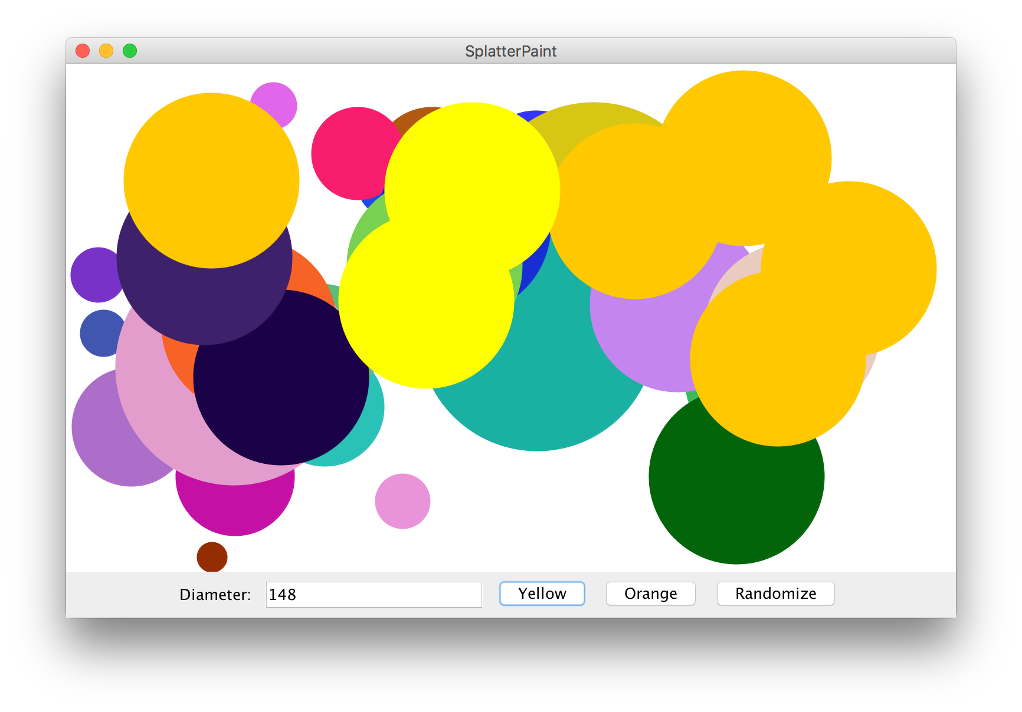
Practice: SplatterPaint

Slide 64
Practice: SplatterPaint
Add a new ”splatter” (e.g. GOval) every time the user clicks on the “Yellow” or “Orange” buttons.
If the user hits “ENTER” instead, add a Yellow splatter.
The splatter’s diameter should be what is entered in the text box (assume it’s valid), and placed randomly entirely onscreen.
If the user clicks “Randomize”, all onscreen splatters should be changed to different random colors.

Slide 65
Solution: SplatterPaint
If “Yellow” is clicked OR IF ENTER IS PRESSED, add a splatter with the diameter in the text field to the screen in yellow
If “Orange” is clicked, add a splatter with the diameter in the text field to the screen in orange
If “Randomize” is clicked, iterate over all splatters and change their color

Slide 66
SplatterPaint.java
public class SplatterPaint extends GraphicsProgram {
// The width of the diameter text field (in chars)
private static final int DIAMETER_FIELD_WIDTH = 15;
// The field for entering the splatter diameter
private JTextField diameterField;
// A list of all onscreen splatters
private ArrayList<GOval> splatters;
...
}

Slide 67
SplatterPaint.java
public void init() {
splatters = new ArrayList<GOval>();
// Add the text field
add(new JLabel("Diameter: "), SOUTH);
diameterField = new JTextField(DIAMETER_FIELD_WIDTH);
diameterField.setActionCommand("Yellow");
diameterField.addActionListener(this);
add(diameterField, SOUTH);
// Add the buttons
add(new JButton("Yellow"), SOUTH);
add(new JButton("Orange"), SOUTH);
add(new JButton("Randomize"), SOUTH);
addActionListeners();
}

Slide 68
SplatterPaint.java
public void actionPerformed(ActionEvent e) {
if (e.getActionCommand().equals("Yellow")) {
// Add a yellow circle
int diameter =
Integer.parseInt(diameterField.getText());
addSplatter(diameter, Color.yellow);
} else if (e.getActionCommand().equals("Orange")) {
// Add an orange circle
int diameter =
Integer.parseInt(diameterField.getText());
addSplatter(diameter, Color.orange);
} else if (e.getActionCommand().equals("Randomize")) {
// Randomize all existing splatters
randomizeColors();
}
}

Slide 69
SplatterPaint.java
private void addSplatter(int diameter, Color color) {
int x = RandomGenerator.getInstance()
.nextInt(0, getWidth() - diameter);
int y = RandomGenerator.getInstance()
.nextInt(0, getHeight() - diameter);
GOval splatter = new GOval(x, y, diameter, diameter);
splatter.setFilled(true);
splatter.setColor(color);
add(splatter);
splatters.add(splatter);
}

Slide 70
SplatterPaint.java
private void randomColors() {
for (GOval splatter : splatters) {
Color newColor =
RandomGenerator.getInstance().nextColor();
splatter.setColor(newColor);
}
}

Slide 71
Recap
Announcements
HashMaps
Classes
Interactors
Final Exam Tips

Slide 72
Final Exam Tips
Look over all problems before starting
Pseudocode!
Show your work
Practice practice practice
Review common programming paradigms
Iterating over a string
actionPerformed
…

Slide 73
Final Exam Tips
Reflect on how much you’ve learned in just 1 quarter!

